Slide 1
User Interface standards
Group 09 UI Team - Mariusz & Taavi

Slide 2
User interface requirements
Use case list
Error conditions

Slide 3
Mock-up*
SceneBuilder / Java 13 / JavaFX 13 / JSON Simple 1.1
*Views are not final and are subject to change

Slide 4
Use case list
2.2.1 User can resize window of the app
2.2.2 User can look at dictionary of all words
2.2.3 User can search for words from the dictionary
2.2.4 User can search for words starting with a specific letter
2.2.5 User can scroll list of words to find desired word
2.2.6 User can add/remove words to/from their Practice List
2.2.7 User can add new words into the dictionary
2.2.8 User can change the language by which words are sorted
2.2.9 User can remove words from the dictionary
2.2.10 User can edit words from dictionary
2.2.11 User can clear the whole Practice list
2.2.12 User can revise words from the Practice List
2.2.13 User can use flashcards to revise
2.2.14 User can take tests
2.2.15 User can change settings for practice
2.2.16 User can change the size of the font
2.2.17 User can look at help section
If you want to come back to this list while on the other slides - click me

Slide 5
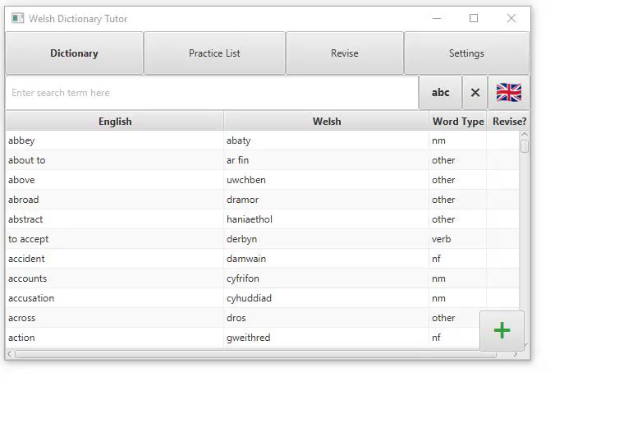
2.2.1 User can resize window of the app
I AM A VIDEO
User can resize the window by dragging the corners of the app.

Slide 6
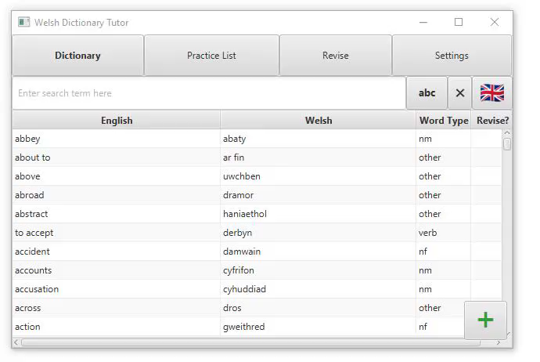
2.2.2 User can look at dictionary of all words
I AM A VIDEO
User can navigate to the dictionary by selecting the “DICTIONARY” button in the main bar along the top of the screen. Once selected the list of all words is displayed each showing a column for English, Welsh, and type of word. Type of word describes whether the word is masculine or feminine noun in welsh or if it is a verb as well as an ‘other’ type.

Slide 7
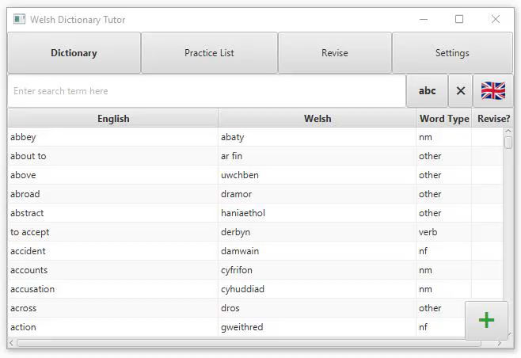
2.2.3 User can search for words from the dictionary
I AM A VIDEO
User can use the search box to look up words they desire. The user will then see a list of words matching what is currently typed into the search bar, the list is narrowed in real time as the word is being typed.

Slide 8
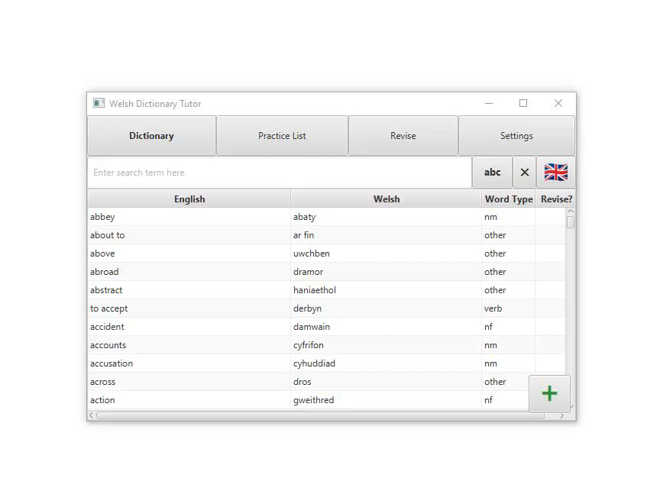
2.2.4 User can search for words starting with a specific letter
I AM A VIDEO
When the user wishes to narrow down the list to words that start with a specific letter, they can use the button labelled “abc”. When pressed, a menu composed of the current active language’s alphabet is opened. Each letter is a separate button and clicking on one closes the window, filling out the search bar with that letter.

Slide 9
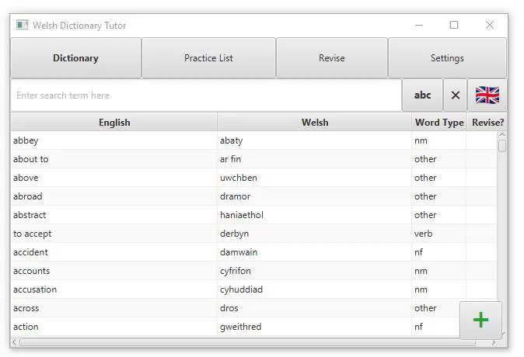
2.2.5 User can scroll the list of words to find desired word
I AM A VIDEO
User can scroll the list by dragging the scroll pane located on the right side of the window. The scroll can be dragged either up or down. Furthermore, the user can choose to scroll with his mouse or touchpad.

Slide 10
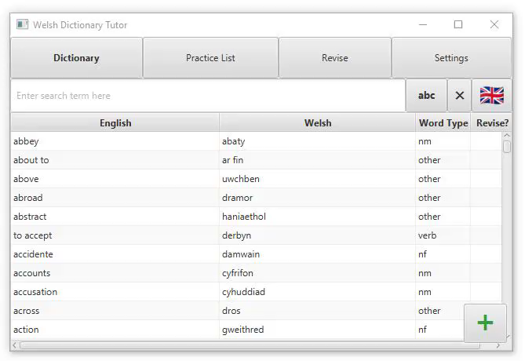
2.2.6 User can add/remove words to/from their Practice List
I AM A VIDEO
The user wants to add a word to their Practice List, they do this by selecting “DICTIONARY” in the main bar along to top of the application. Once on the DICTIONARY page they double click on the desired word. The word is then added to the practice list, showing the “Revise?” column to have a checkmark. They view the newly favourited word by selecting “PRACTICE LIST” section in the main bar along to top of the application. Removal works the same, requiring a double click on a practiced word, removing the checkmark and the word itself from the Practice List.

Slide 11
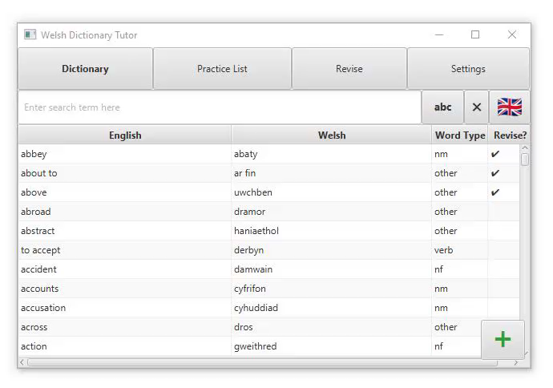
2.2.7 User can add new words into the dictionary
I AM A VIDEO
The user wants to add a new word to their dictionary, they press the floating green plus button located on the bottom right corner of the window. A dialog box is opened in the middle of the screen consisting of the English and Welsh definition boxes and a drop-down menu to select the word type. There is a “Add new word” button that is inactive on opening. Once the user has filled in all the required boxes, the button “Add new word” changes colour and becomes active. They click the “Add new word”, the word is added to the Dictionary and Practice List, then the dialog box is closed.

Slide 12
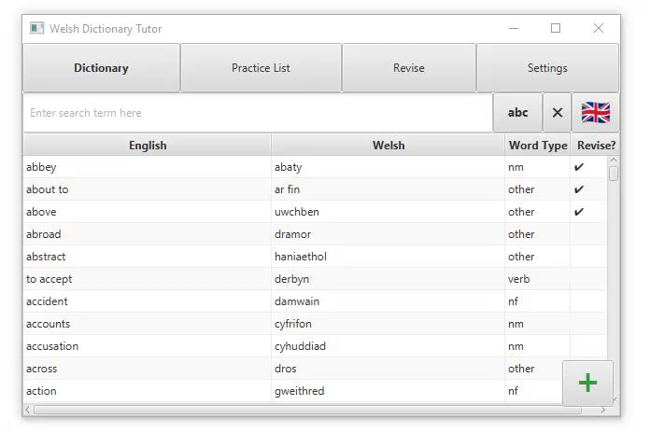
2.2.8 User can change the language by which words are sorted
I AM A VIDEO
The words are automatically sorted by English, the user wants to sort the words by welsh. They do this by clicking on the button located next to the search bar. The button depicts the current language, presented as United Kingdom flag for English and a Welsh flag for Welsh. When clicked, the language in which the words are sorted is changed to Welsh and the button now depicts the Welsh flag. Later if the user wishes they can repeat this action and change the sorting order back to English. The sorting carries over to the narrowing list in Use Case 2.2.2.

Slide 13
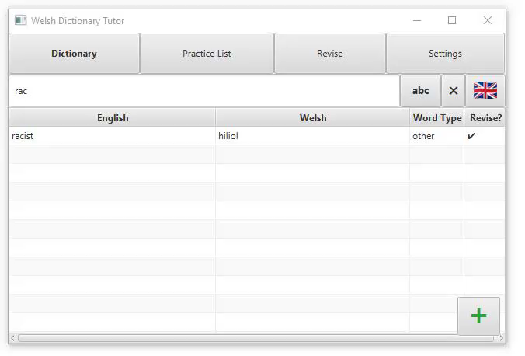
2.2.9 User can remove words from the dictionary
I AM A VIDEO
The user wishes to remove words from dictionary, they right click the word they wish to remove, a drop-down menu is then displayed giving the options “DELETE” and “EDIT”. They select “DELETE”, and the word is removed from the dictionary as well as the Practice List if it was present there.

Slide 14

2.2.10 User can edit words from dictionary
I AM A VIDEO
The user wants to edit words in the dictionary, they do this by right clicking the word. When right clicked a drop-down box is then displayed, giving the options “DELETE” and “EDIT”. They select edit and a dialog window is shown, this contains two textboxes, one drop-down menu and a confirmation button. Here the user edits the English definition, they could also edit the Welsh definition and the type of the word. Once they click the "Revise word” button, the dialog box is closed.

Slide 15
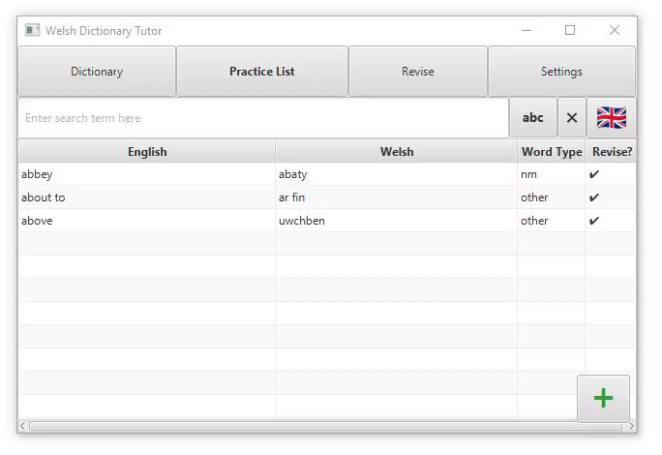
2.2.11 User can clear the whole Practice List
I AM A VIDEO
The user wants to reset their Practice list, remove all words from it. They select the “SETTINGS” button in the main bar along the top of the screen. Once on the settings page the user selects the button labelled “CLEAR PRACTICE LIST” with a description next to it. After clicking the button, all of the words in Practice List will be removed and the Practice List will be empty. A notification message will pop up confirming the clearing of the list.

Slide 16
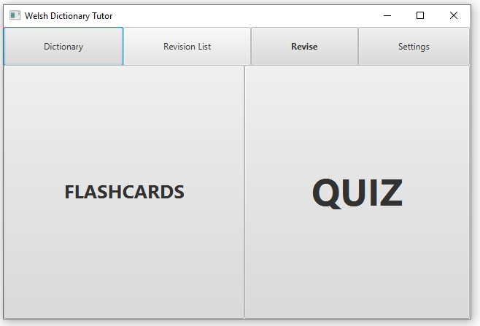
2.2.12 User can revise words from the Practice List
The user wants to revise the words from the Practice List, they click on the button along the top of the screen labelled “REVISE”. This shows them a new page containing two buttons, “FLASH CARDS” and “QUIZ”. From here they can choose two ways to revise, these two options are described in use cases 2.2.12 and 2.2.13.

Slide 17
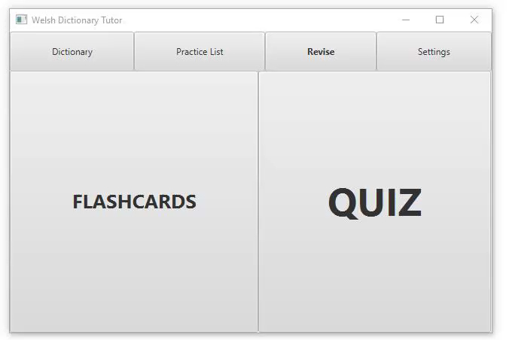
2.2.13 User can use flashcards to revise
I AM A VIDEO
Once the user chooses the “Revise” menu and clicks on the “Flashcard” option, they are presented with a flashcard (only if they have at least one word added to the Practice List). They flip the flashcard to see the definition in the other language by clicking the Flip button. The user clicks the “NEXT” button when they want to see a new word and clicks the “BACK” button when they want to see the previous word.

Slide 18
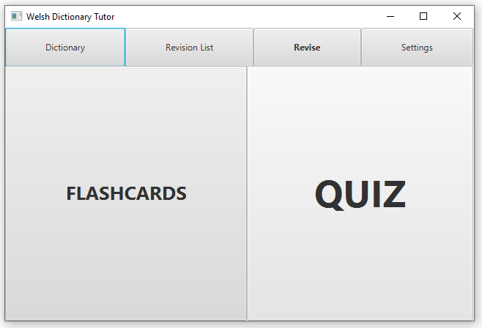
2.2.14 User can take tests
Once the user chooses the “Revise” menu and clicks on the “Quiz” option, they’ll be presented with a quiz of various tests, with the amount dependant on the setting they have chosen in the “Settings” menu. They’ll be presented one of three tests at a time.
There is a running indicator in the form of a progress bar to show how many of the questions the user has answered from the total amount of questions. There is also a numeric indicator for how many questions have been answered correctly out of the total number of questions answered so far. After each question a notification box is presented giving feedback:
If the question is fully correct and positive message with a green background is displayed.
If the question was answered incorrectly then the correct answers are displayed in the popup, on a red background.
Once the quiz is complete the user will see a dialog box giving feedback on how many questions they got correct and incorrect. Once closed they are returned to the “REVISE” section.

Slide 19
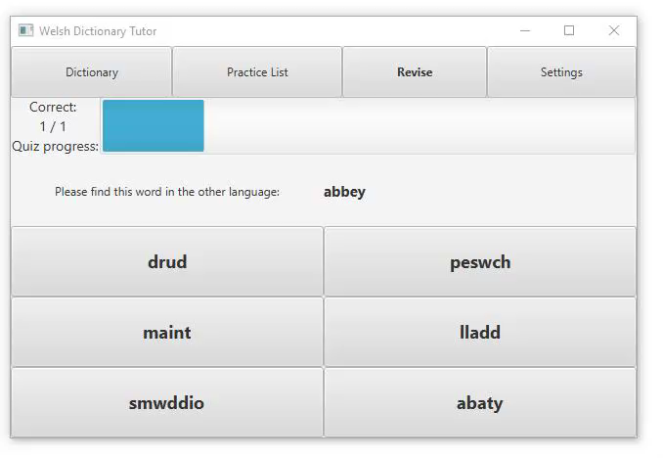
2.2.14 User can take tests
I AM A VIDEO
A) Find the definition – The user will be presented a word in a language (dependant on the language setting in the “Settings”) and they’ll be shown 6 random words from the dictionary in the other language. They must choose the correct matching definition.

Slide 20
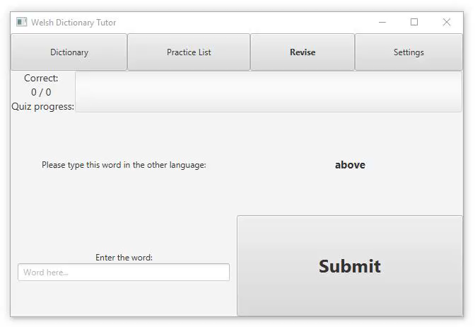
2.2.14 User can take tests
I AM A VIDEO
B) Input box – The user will be presented a word in a language (dependant on the language setting in the “Settings”) and they’ll have an input box. They must write the correct definition in the input box.

Slide 21
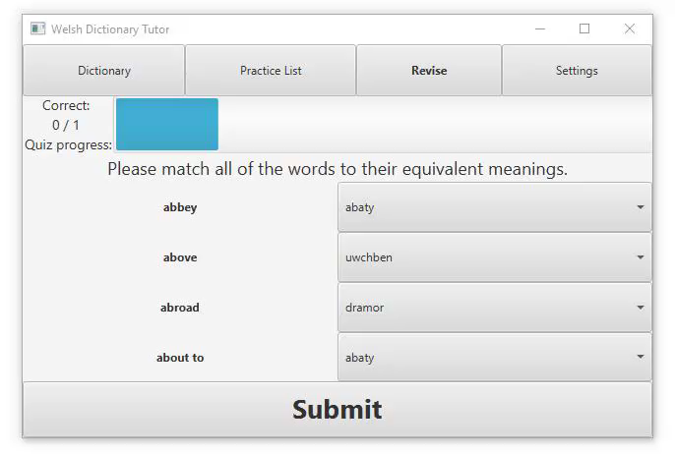
2.2.14 User can take tests
I AM A VIDEO
C) Matching – Only chosen if the user has added at least 4 words into their Practice List. The user is presented 4 words in a language (dependant on the language setting in the “Settings”) and they are shown 4 drop-down menus with the matching definitions to the words. They must match up each word to its correct definition in the other language.

Slide 22
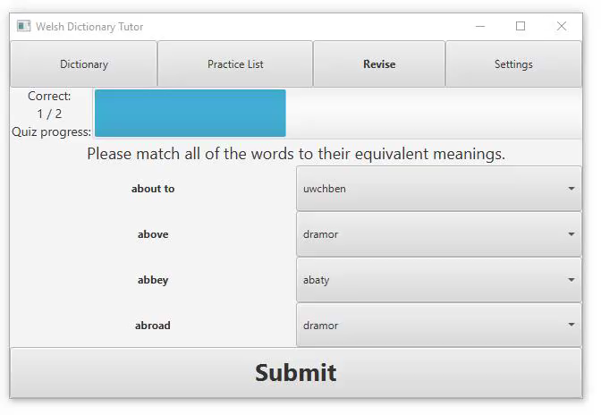
2.2.14 User can take tests
I AM A VIDEO
After each question a notification box is presented giving feed back:
If the question is fully correct and positive message is displayed in the notification box
If the question was answered incorrectly then the correct answers are displayed in the notification box
Once the quiz is complete the user will see a dialog box giving feedback on how many questions they got correct and incorrect. Once closed they are returned to the “REVISE” section.

Slide 23
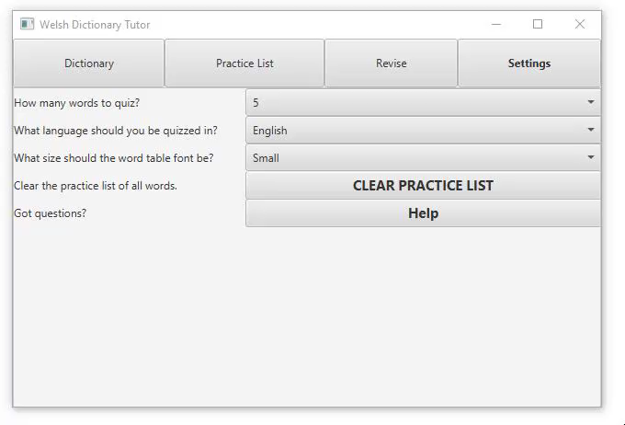
2.2.15 User can change settings for Practice
I AM A VIDEO
User can click on the button “Settings” on the main menu bar at the top of the screen. On the settings page the user can change
- How many tests are used in a single quiz (5 or more in increments of 5 up to a maximum of 30)
- What language should be used for the tests and flashcards (English, Welsh or both)
- Click on the Help button for a help screen

Slide 24
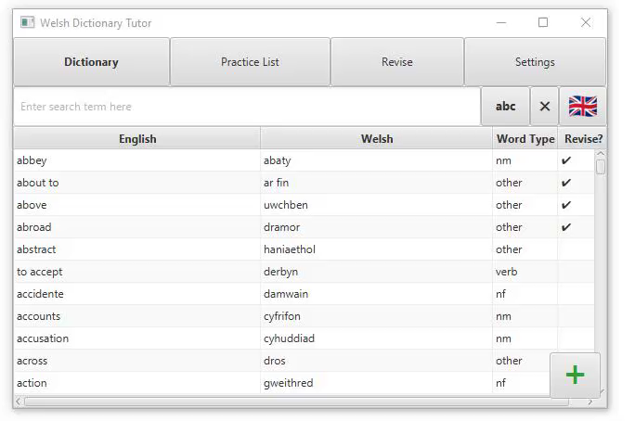
2.2.16 User can change the size of the font
I AM A VIDEO
Welsh Vocabulary Tutor is accessibility friendly. User can change the size of the font presented in the application. Once they click the “Settings” button located in the navigation menu, they can choose from one of three options available
Small – 12 pixels
Medium – 18 pixels
Large – 28 pixels
After choosing those options, the user will see the change of font size in Main and Practice List section.

Slide 25
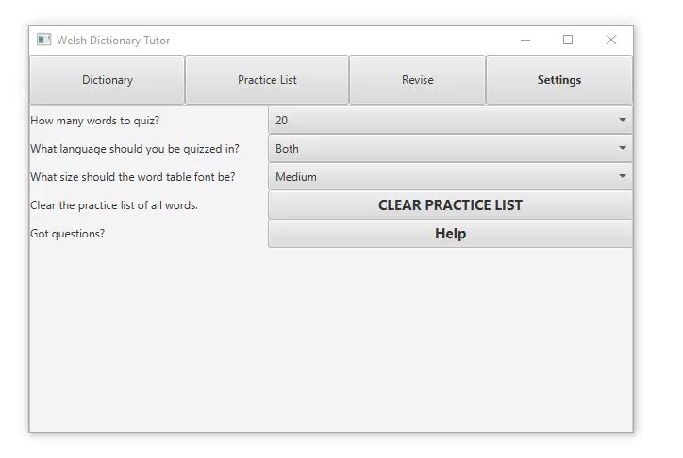
2.2.17 User can look at help section
I AM A VIDEO
User wants help using the app and finds all the instructions how to use the app by clicking on Settings and clicking on “HELP” button. From there the dialog box opens with information on how to use the application.

Slide 26
Error conditions
Empty box - user doesn’t input the word when he is supposed to
Incorrect input - when user input is required it of the wrong type
User chooses to open Revise section where there are no words added to Practice list

